Slide 1

Camera Motion Sensor Using ESP32
Prepare by Anurag & Axay
Guided by Dhara j. Sangani

Slide 2
01
Introduction to Camera Motion Sensors
02
Designing the Motion Sensor System
03
Developing the Motion Detection Software
CONTENT
04
Testing and Applications of the System
05
Future Developments and Enhancements

Slide 3
Introduction to Camera Motion Sensors
/
01

Slide 4
Overview of Camera Motion Sensors
Importance of Motion Detection
Applications in Various Fields
Motion detection is crucial for reducing false alarms, optimizing resource usage, and ensuring timely responses to potential threats, thereby improving the overall safety and security infrastructure.
Definition and Purpose
These sensors find applications in security systems, home automation, automotive safety, and motion-activated camera systems, offering increased efficiency and better monitoring capabilities across various sectors.
Camera motion sensors are devices designed to detect movement in their field of view. Their primary purpose is to enhance security, automate lighting, and enable user interaction with digital environments.

Slide 5
ESP32 Overview
Advantages Over Other Microcontrollers
Compared to other microcontrollers, ESP32 stands out due to its dual-core architecture, integrated connectivity options, and robust development ecosystem, facilitating rapid prototyping and deployment of IoT solutions.
Key Features and Specifications
What is ESP32?
Notable features include high processing speed, low power consumption, extensive GPIO support, and built-in support for numerous communication protocols, making it a versatile choice for embedded systems.
ESP32 is a powerful, low-cost microcontroller equipped with Wi-Fi and Bluetooth capabilities, designed for a variety of IoT applications. It features dual cores, allowing for multitasking and efficient performance in handling multiple processes.

Slide 6
Designing the Motion Sensor System
/
02

Slide 7
Components Required
ESP32 Module
Camera Selection
Additional Sensors and Modules
The ESP32 module serves as the brain of the motion detection system, executing code for image processing and communication with other components, ensuring timely response to detected movements.
Selecting the right camera is vital; considerations include resolution, field of view, and compatibility with the ESP32 to ensure that it effectively captures and processes motion images.
Additional sensors such as PIR (Passive Infrared) sensors can enhance motion detection. Modules for connectivity, like relays or lights, can also be included for automated responses to detected movements.

Slide 8
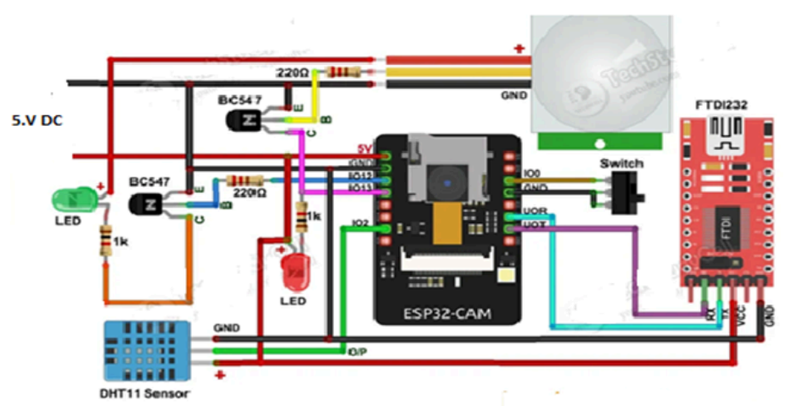
Circuit Diagram and Connections

Slide 9
Developing the Motion Detection Software
/
03

Slide 10
Programming Environment Setup
Required Software and Tools
Installation and Configuration
Identify essential software tools such as the Arduino IDE or PlatformIO, necessary libraries for camera functionality, and libraries for image processing and motion detection.
Outline steps for installing the required software and libraries, along with configuration settings that ensure compatibility with the ESP32 and selected camera modules.

Slide 11
Code Structure and Logic
1
2
3
Key Libraries and Functions
Motion Detection Algorithm
Integration with Camera Feed
Discuss libraries essential for camera operations, such as the ESP32 camera library, and libraries for Wi-Fi connectivity that will support real-time transmission of motion data.
Describe the algorithm used for detecting motion, detailing methods such as background subtraction or frame differencing to effectively identify movement.
Elaborate on how to integrate motion detection logic with the camera feed, allowing the system to process images in real-time and respond appropriately to detected motion.

Slide 12
Testing and Applications of the System
/
04

Slide 13
Testing Procedures
Performance Evaluation
Evaluate the system’s performance by testing its accuracy in detecting motion, analyzing response times, and ensuring it meets predefined operational criteria.
1
Unit Testing Components
Conduct unit testing for each individual component, ensuring that both the ESP32 and the camera module function correctly before full system integration.
3
2
System Integration Testing
Perform integration testing to verify that all components work seamlessly together, assessing the performance of the motion detection system under various scenarios.

Slide 14
Real-world Applications
Security Systems
The system can be integrated into security frameworks, providing surveillance capabilities that trigger alerts via notifications or activate alarms upon detecting movement.
Smart Home Automation
In smart homes, the motion sensor can control lighting and appliances, integrating with systems such as smart locks and indoor cameras to
enhance convenience and security.
Robotics and Drones
The technology can be applied in robotics and drones for navigation and surveillance tasks, allowing autonomous systems to detect and respond to their environment effectively.

Slide 15
Future Developments and Enhancements
/
05

Slide 16
Current Trends in Motion Detection
Advances in AI and Machine Learning
Integration with IoT Devices
Incorporating AI and machine learning can improve motion detection accuracy and enable advanced features such as object classification and facial recognition.
Future developments will see deeper integration with IoT devices, allowing for cooperative functionality, real-time data sharing, and centralized control systems for enhanced automation.

Slide 17
Potential Improvements
Enhancing Detection Accuracy
Power Consumption Optimization
Future enhancements could focus on refining detection algorithms to reduce false positives and adapt to varying environments and lighting conditions for improved reliability.
Emphasizing power efficiency, future designs may incorporate energy-saving modes and require less power, enabling longer operation times without frequent battery replacements.
Expanding Functionality
The system could evolve to include additional features such as remote monitoring, cloud storage for captured footage, and the ability to integrate with different communication protocols for broader application possibilities.

Slide 18
Thank you for listening.

